Slide 1
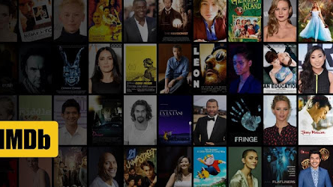
A linear regression analysis of IMDB worldwide gross
Presented by: Mert, Osman, Büşra
As Project 2 of
ISTDATA Data Science Bootcamp

Slide 2
Outline
Webscraping
Data Cleaning – EDA
Linear Regression Model
Conclusion

Slide 3
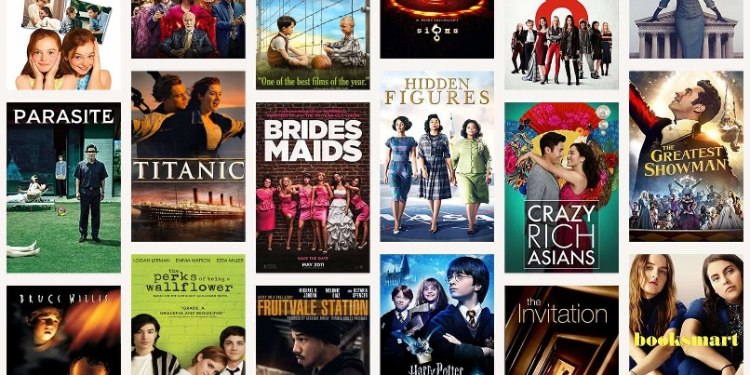

Introduction
INTRODUCTION
Goal
Predict the IMDB worldwide gross for top 3000 movies.
Solution:
Obtaining and analyzing movie data from IMDB and the-numbers web site with web scrapping method.

Slide 4





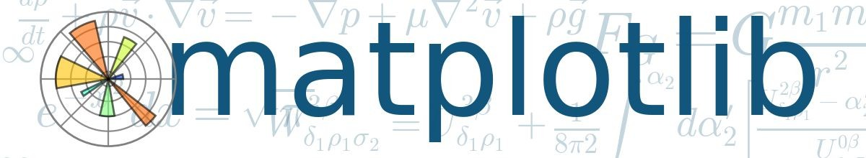
Tech-Slack
Data was scraped from IMDB TOP 3000 Movies & the-numbers.com
Beautifulsoup
Scraped data from imdb.com & the-numbers.com
SciKit-Learn and statsmodels
Used to build and interpret linear models
Pandas/Numpy
Used to clean, prepare, and explore data
Matplotlib and Seaborn
Create visualizations of results
Notes:
IMDB => 12 sütun 3000 satırdan bir dataframe oluşturdum
The-numbers => 5 sütun 6198 satırdan bir dataframe oluşturduk. Bu iki dataframe’i moviename ile join yaparak tek bir dataframe oluşturduk.

Slide 5
METHODOLOGY
01
02
Data Preparation
Scraped and cleaned relevant data
Removed/formatted data for modeling
Created dummy variables for categorical features
Graph + Analysis
Created multiple visualizations of key relationships
03
04
Feature Engineering
Found interactions between worldwide gross based features.
Modeling
Used Linear, LASSO and Ridge, for analysis
Used cross validation.

Slide 6
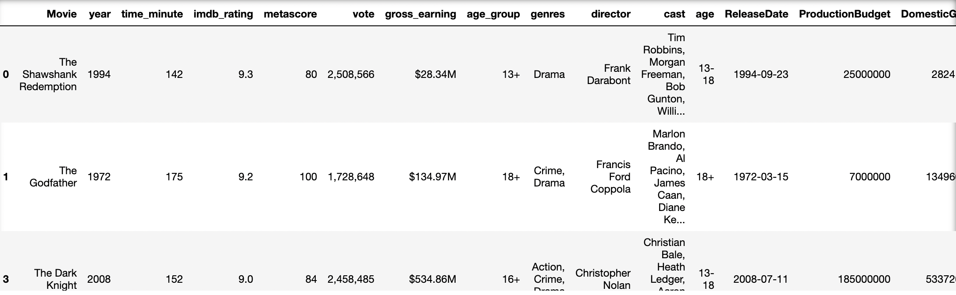
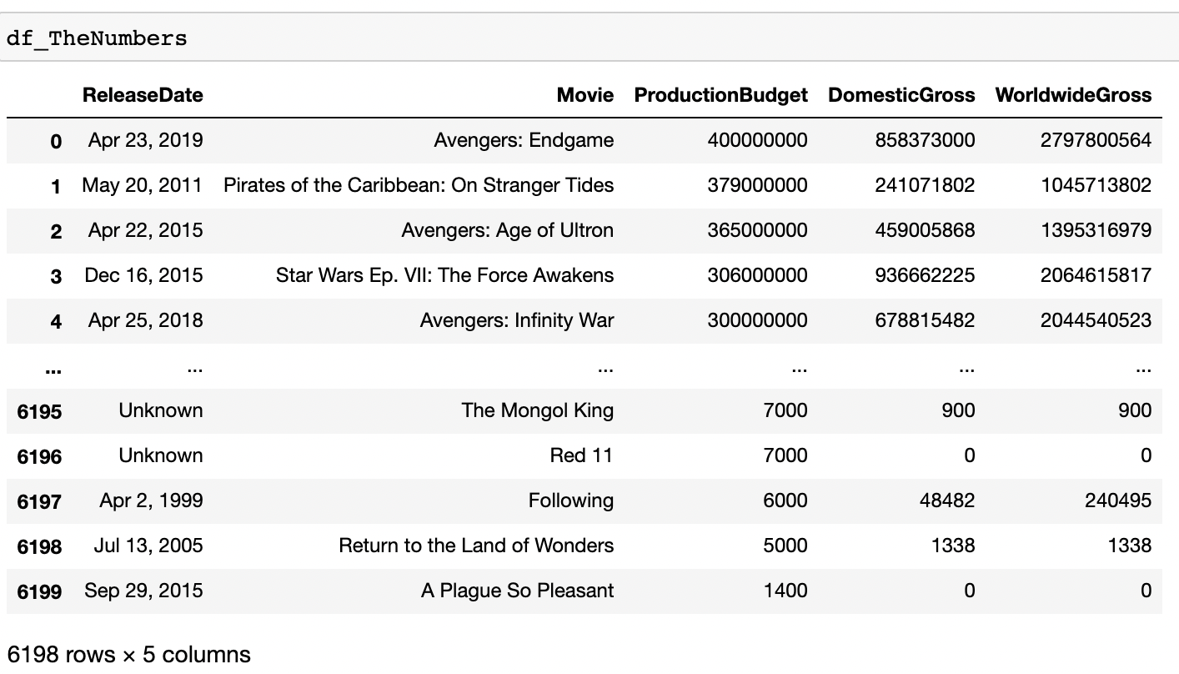
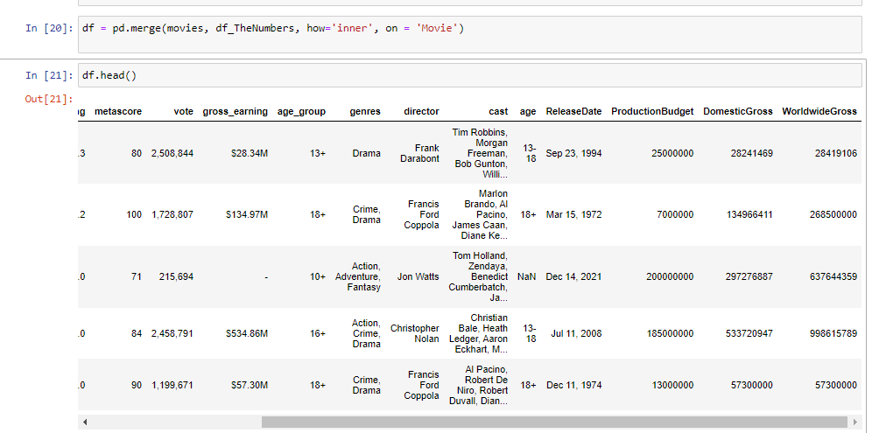
IMDB DF
The-numbers DF

Slide 7
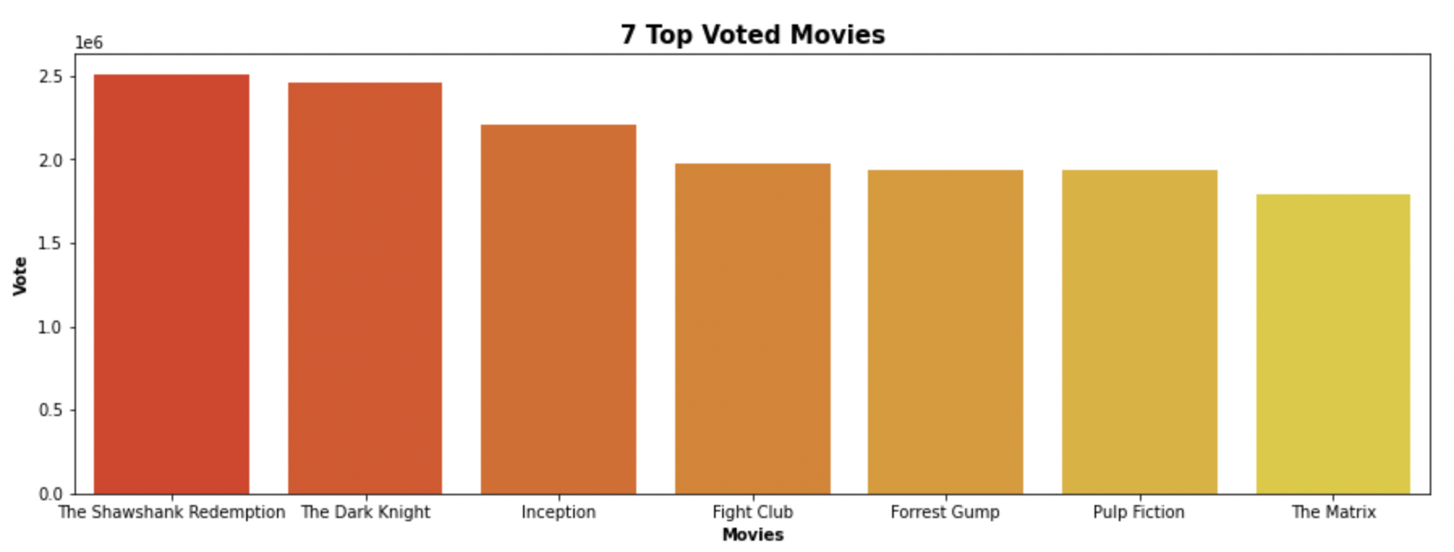
TOP 7 Voted Movies

Slide 8
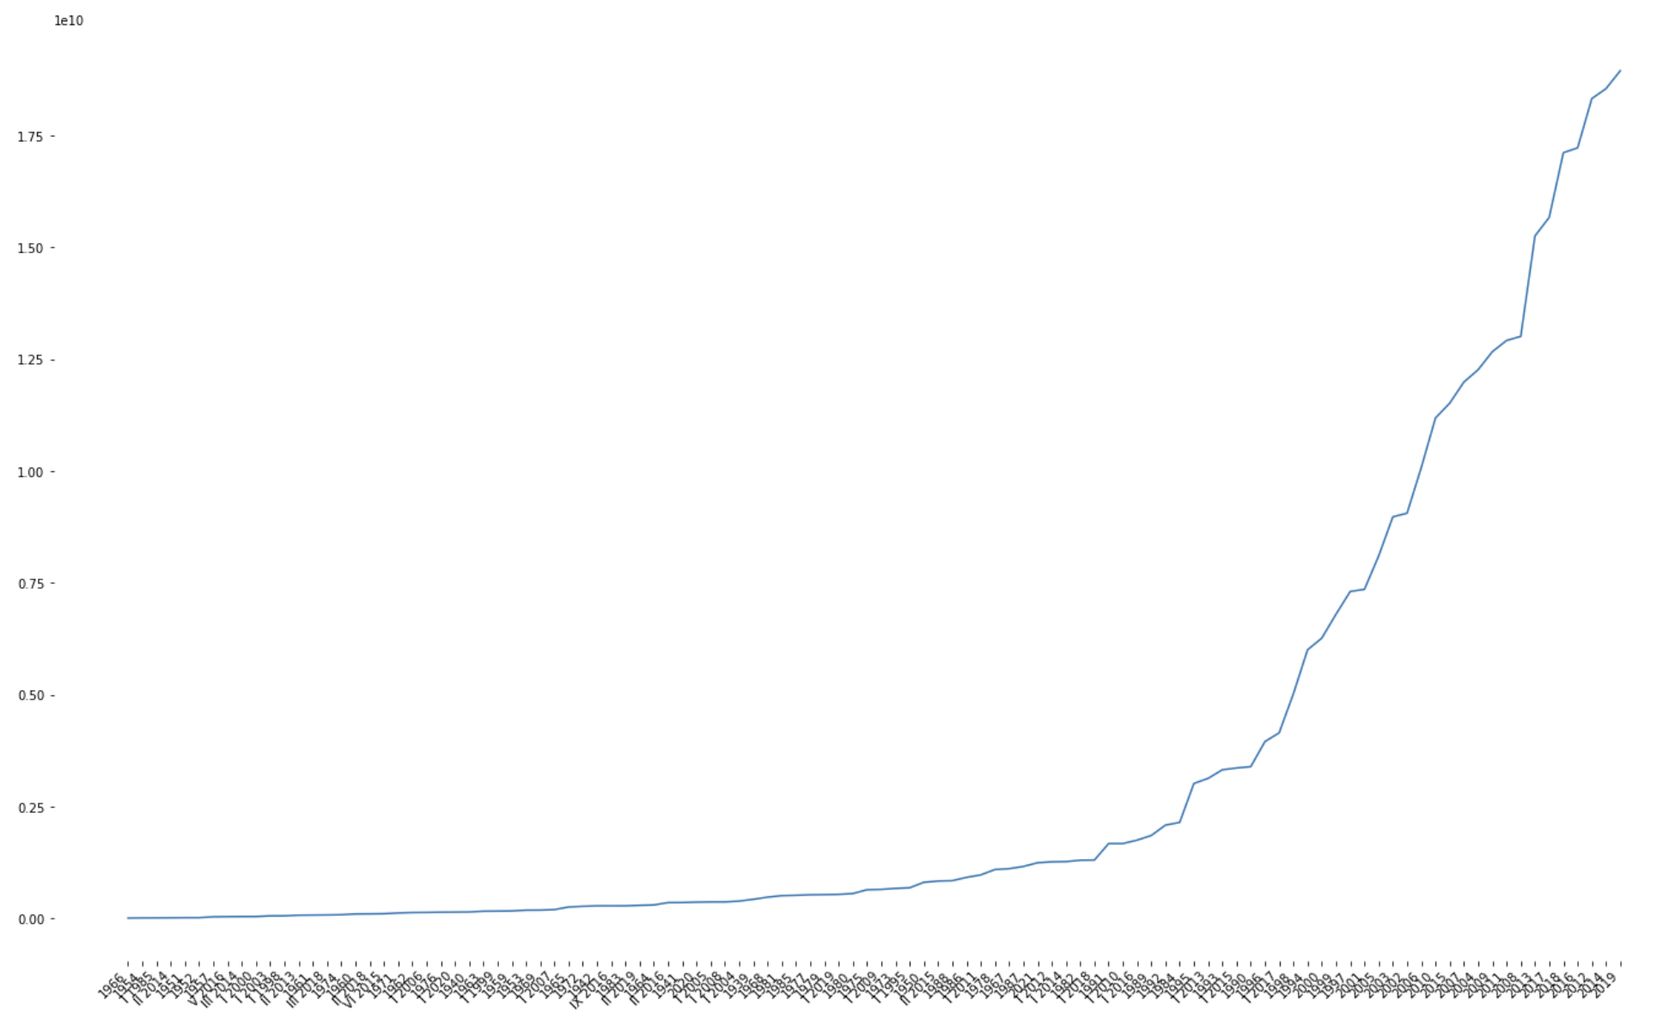
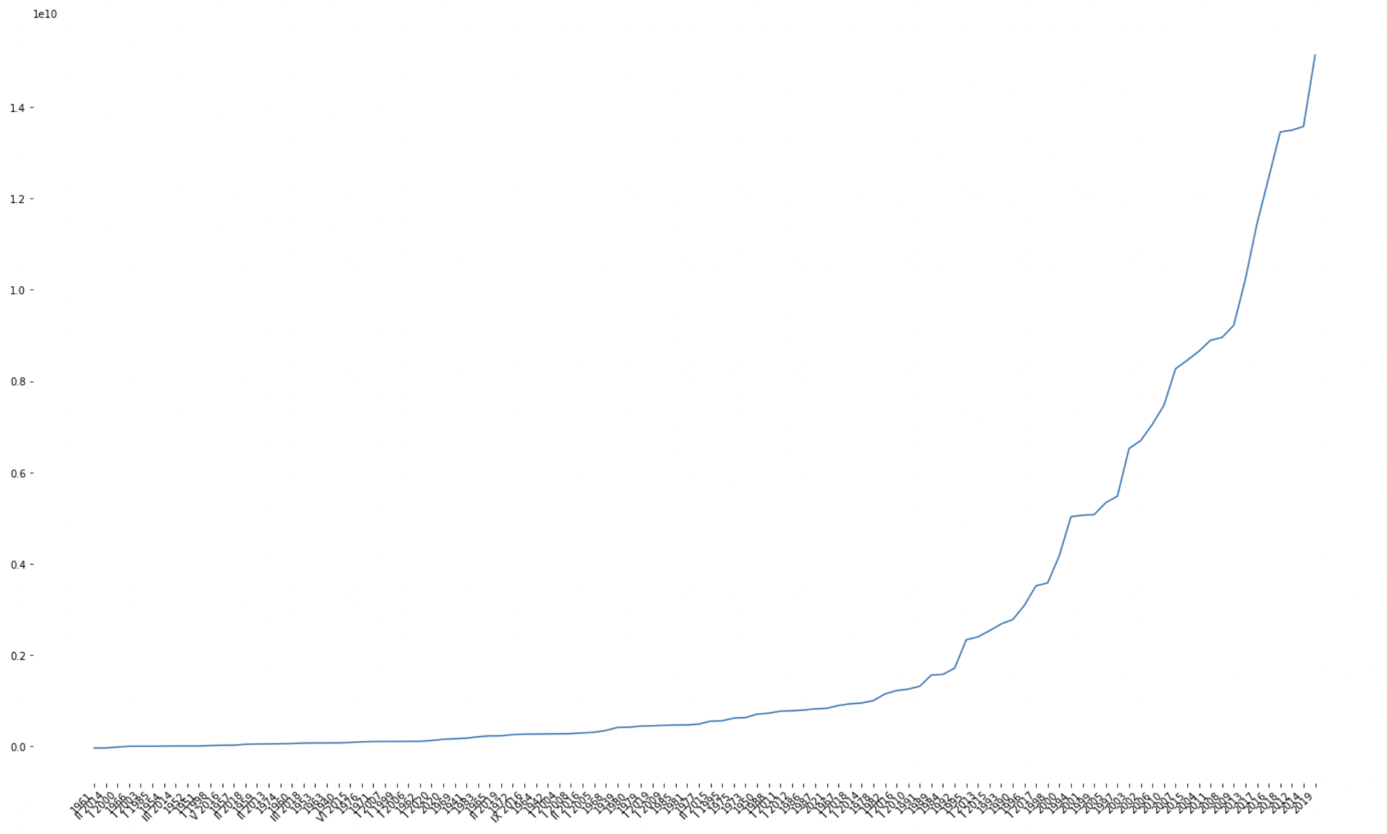
Worldwide Gross vs. Year
RESULTS
Net Profit vs. Year
World Wide Gross data increases over the years
Net Profit data increases over the years
1966 2019
1966 2019

Slide 9
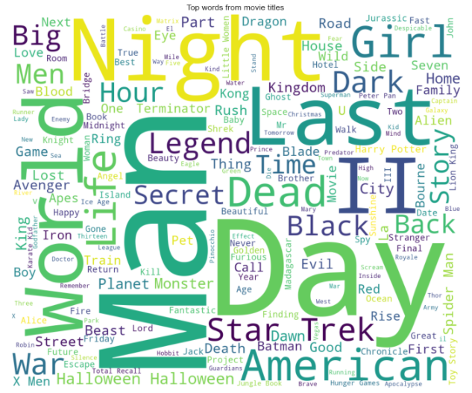
TOP WORDS FROM MOVIE TITLE
Notes:
WORLD COUNT KÜTÜPHANESİNİ KULLANARA MOVİE TITLE’DA EN ÇOK GEÇEN KELİMELERİ YAKALADIK

Slide 10










Feature Included In The Model
PRODUCTION BUDGET
RUNTIME
VOTE
WEEKEND
Weekday
GENRE COUNT
G
SUCCESS DIRECTORS
SUCCESS ACTOR
Q2
13-18
SHORT
Q3
Q4
18+
WORLDWIDE GROSS
LONG
TARGET
Notes:
G => GENEL İZLEYİCİ , DUMMY OLARAK YILI ÇEYREKLERE BÖLDÜK, TOP 100 DEKİ DİRECTORLER SUCCESS DİREKTORDÜR. , TOP 100 DEKİ AKTÖRLER SUCCESS AKTÖRDÜR

Slide 11
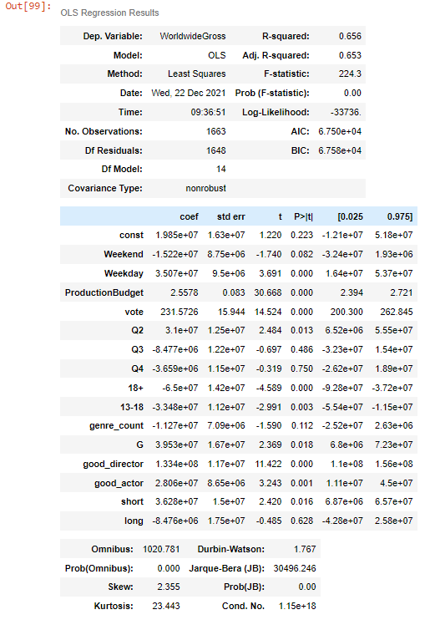
OLS REGRESSION RESULT

Slide 12
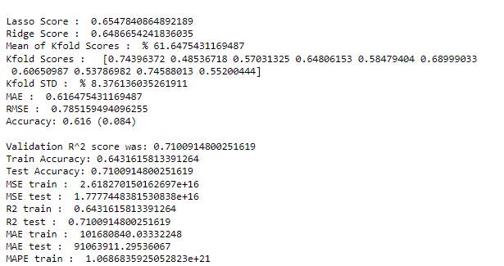
TRAINED MODEL RESULTS

Slide 13
FEATURE WORK
Collect more data
Collect more feature for target (opening weekend, Oscar Awards…)
Try different Regression models and pipelines.

